Slide 1
Real Time Video Analysis
By Pooja Shekhar(23)

Slide 2
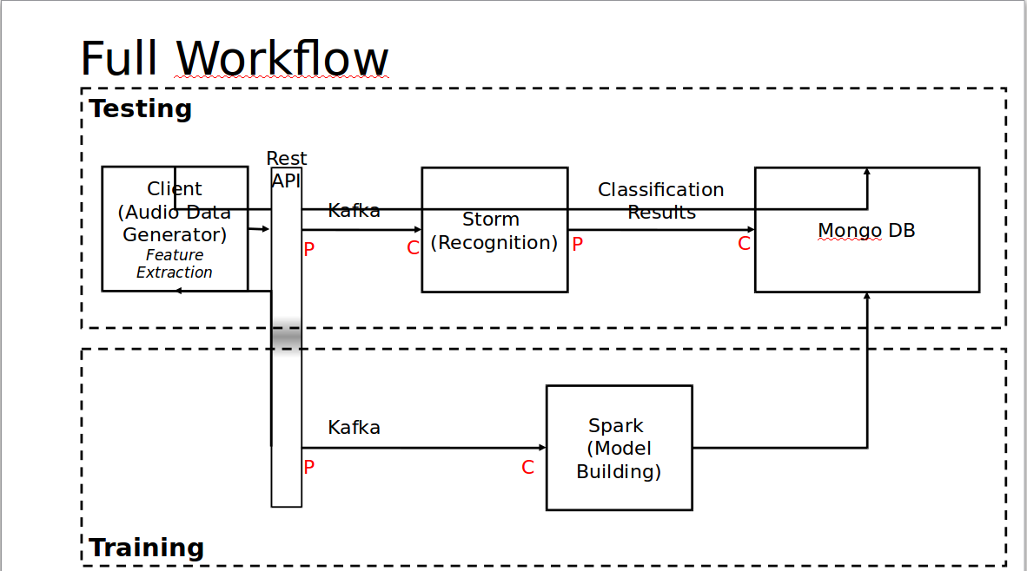
System Architecture
Training Side – Finished Implementation
Trained Model not sent in mLab due to technical issues.

Slide 3
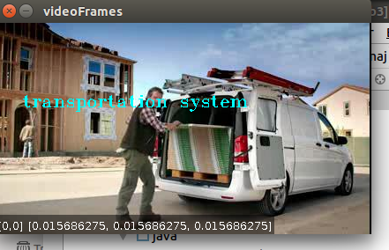
Scene Categorization
Scene Categorization is a term that is usually used to refer to the problem of recognizing the semantic label (e.g. travel, home, transportation etc.) of a single image. This project designs a technique to identify the categories of a scene

Slide 4
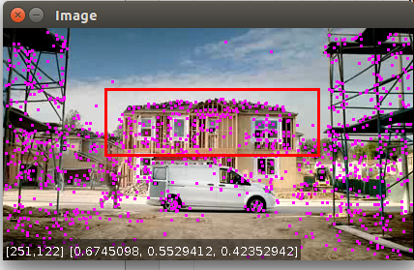
Other Objectives
Object Tracking
Image Classification
CONFUSION MATRIX:
166.0 63.0 47.0
281.0 1427.0 405.0
84.0 140.0 364.0
F-MEASURE: 0.6817523304581611
RECALL: 0.6573731944910984
PRECISION: 0.7384695474593782

Slide 5
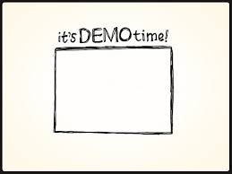
Url: https://youtu.be/Zb6K8MzWvN4

Slide 6


